Slide 1
Contemporary Abolitionists
Civil Disobedience Walden, a game EDU
Notes:
Please note, we are using ALL images found in these slides for educational use only under the Fair Use legal doctrine. All images & their copyright belong to their respective photographer.

Slide 2
Ava Duvernay (b. 1972)
Directed 13TH
A documentary which critically examines the American prison system as both a legacy of slavery and a system of oppression
Award-winning director & filmmaker
Quote: “If I could, I would abolish prisons. Literally. Factually, statistically, again and again for decades, it has been shown that incarceration does not improve rates of crime. It just doesn’t. It’s the wrong way to do it. Some folks see that as radical, but I’m a prison abolitionist. Incarceration is a money-making venture for some private companies. It doesn’t help people. It doesn’t help the communities. It doesn’t help the victims. It doesn’t truly help us grow as a society. The way that we punish is so arcane, outdated and just ridiculous that we’re spending money to let people out of prison who have not been reformed or rehabilitated. It’s a vicious, ridiculous cycle.”

Slide 3
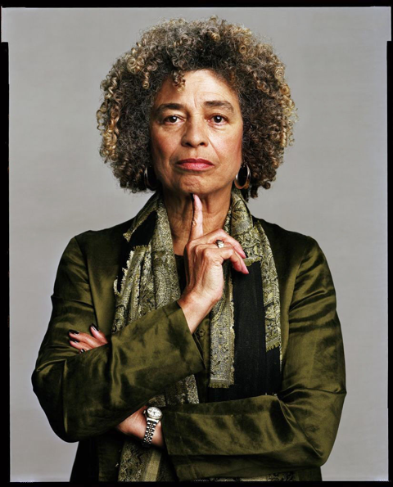
Angela Davis (b. 1944)
Political activist, professor, and writer
Quote: “One may perceive in the penitentiary many reflections of chattel slavery as it was practiced in the South. Both institutions subordinated their subjects to the will of others. Like Southern slaves, prison inmates followed a daily routine specified by their superiors. Both institutions reduced their subjects to dependence on others for the supply of basic human services such as food and shelter. Both isolated their subjects from the general population by confining them to a fixed habitat. And both frequently coerced their subjects to work, often for longer hours and for less compensation than free laborers.” -- from Are Prisons Obsolete?, 2003

Slide 4
Mariame Kaba
Personal information protected
Community organizer, writer, and curator
Quote: “Enough. We can’t reform the police. The only way to diminish police violence is to reduce contact between the public and the police... There is not a single era in United States history in which the police were not a force of violence against black people. Policing in the South emerged from the slave patrols in the 1700 and 1800s that caught and returned runaway slaves. In the North, the first municipal police departments in the mid-1800s helped quash labor strikes and riots against the rich. Everywhere, they have suppressed marginalized populations to protect the status quo.” -- from the New York Times Opinion, “Yes, We Mean Literally Abolish the Police”, published July 2020

Slide 5
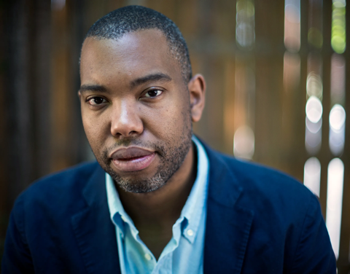
Ta-Nehisi Coates (b. 1975)
Writer & Journalist
Author of Between the World and Me, We Were Eight Years in Power, and The Water Dancer
Also co-wrote Marvel’s The Black Panther from 2016-2021
Quote: “Perhaps after a serious discussion and debate—the kind that HR 40 proposes—we may find that the country can never fully repay African Americans. But we stand to discover much about ourselves in such a discussion—and that is perhaps what scares us. The idea of reparations is frightening not simply because we might lack the ability to pay. The idea of reparations threatens something much deeper—America’s heritage, history, and standing in the world.” -- from The Case for Reparations, 2014

Slide 6
Eve Ewing (b. 1986)
Writer, professor, community organizer, artist, and poet
Quote: “Ever since black people came to this country we have needed a Moses. There has always been so much water that needs parting. It seems like all black children, from the time we are born, come into the world in the midst of a rushing current that threatens to swallow us whole if we don't heed the many, many warnings we are told to heed. We come into the world as alchemists of the water, bending it, willing it to bear us safe passage and cleanse us along the way, to teach us to move with joy and purpose and to never, ever stop flowing forward into something grand waiting at the other end of the delta. We're a people forever in exodus.” -- from Electric Arches, 2017

