Slide 1
Abolitionists & more in the 19th century
Civil Disobedience Walden, a game EDU
Notes:
NOTE TO TEACHERS FROM THE WALDEN TEAM:
There are a lot of slides here -- pick and choose which go best with your lesson plans!
Please note, we are using ALL images found in these slides for educational use only under the Fair Use legal doctrine.

Slide 2
HISTORICAL CONTEXT

Slide 3
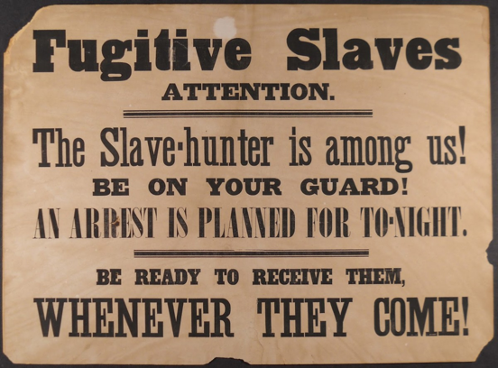
Fugitive Slave Acts of 1793 and 1850
Authorized enslavers and their “agents” to capture and return runaway enslaved people, anywhere in the U.S. territory
This included within borders of “free” states
Created harsher penalties on those who aided and abetted formerly enslaved people
Some of the most violated pieces of federal legislation in American history
Most Northern states intentionally neglected to enforce the law, and passed laws to protect freedom chasers
Nicknamed the “Bloodhound Bill” by abolitionists
Especially after the passage of the second act in 1850, this was considered one of the causes of the Civil War

Slide 4
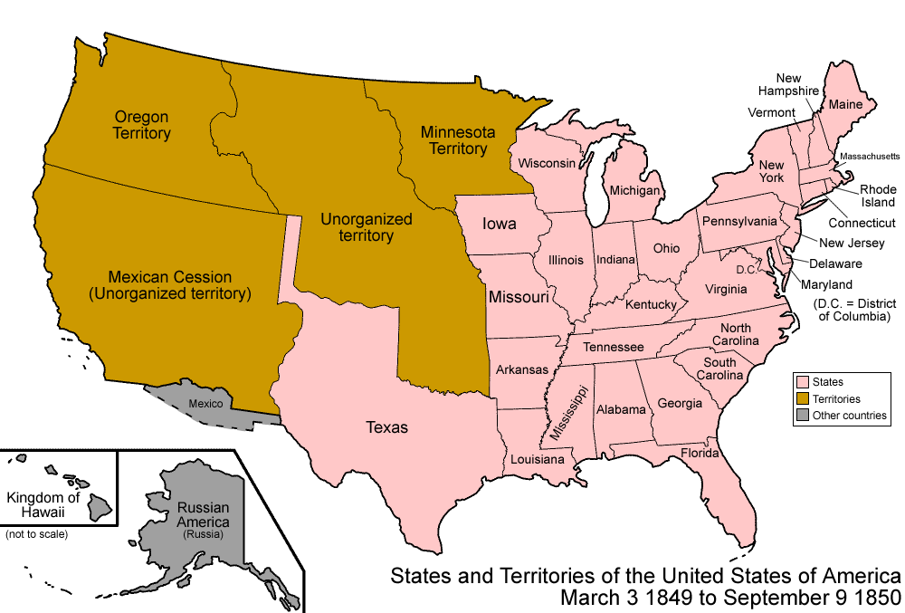
War with México (1846-48)
The United States went to war with México to colonize more territory, as a result of American “manifest destiny” philosophy
Stemmed from the 1845 U.S. annexation of Texas
After U.S. “victory”, México lost one-third of its territory
National dispute in the U.S.: would slavery be permitted in the new Western territories?
Texas would be admitted as a “slave state”: one in which slavery was legal
Southern states threatened to secede
Led to the Compromise of 1850

Slide 5
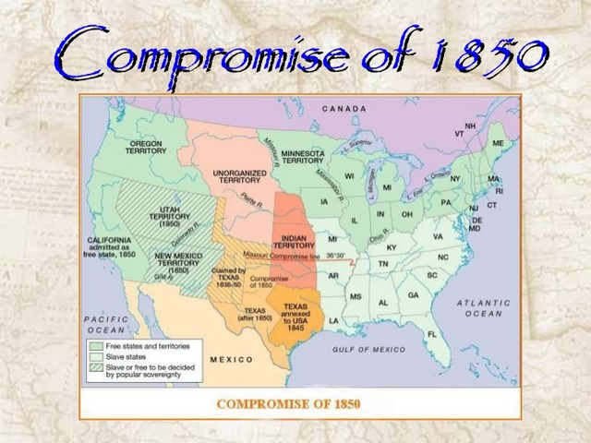
Compromise of 1850
A compromise made up of 5 bills
Meant to resolve the burning issue of slavery’s legality in the new U.S. territories, afte the Mexican-American war
Main points:
Slavery permitted in Washington D.C.
Greater slave trade outlawed
California is a “free” state
Utah & New Mexico can decide via popular sovereignty if they would permit slavery
New boundaries for the state of Texas

Slide 6
PEOPLE, ACTIONS, & MOVEMENTS

Slide 7
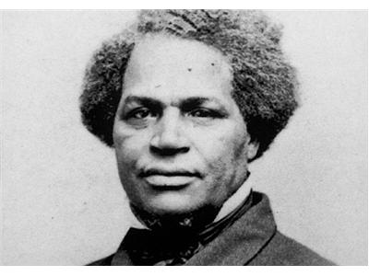
David Walker (1796-1830)
Lived in Boston, Massachusetts
Writer & community activist
Distributed pamphlets of his writing to his community
Believed that Black Americans should take action to liberate themselves
Believed in education as a tool to liberate Black people
Quote: “They think because they hold us in their infernal chains of slavery, that we wish to be white, or of their color—but they are dreadfully deceived—we wish to be just as it pleased our Creator to have made us, and no avaricious and unmerciful wretches, have any business to make slaves of, or hold us in slavery . . .” -- from Appeal to the Coloured Citizens of the World, 1830

Slide 8
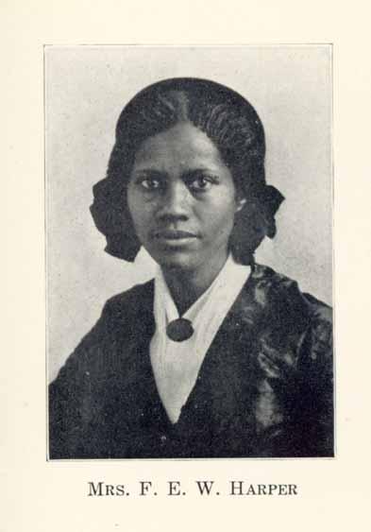
Frances Ellen Watkins Harper (1825-1911)
Born in Maryland, active on the East Coast
Writer & Poet → not all abolitionists were “on the ground” organizers
One of the first Black women to be published in the U.S.
Quote: Excerpt from the poem “The Slave Auction”
And mothers stood with streaming eyes
And saw their dear children sold
Unheeded rise their bitter cries,
While tyrants bartered them for gold.

Slide 9
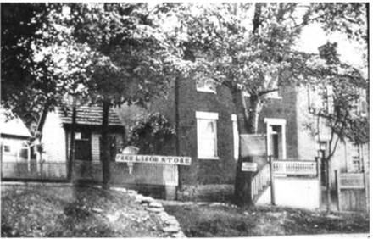
Free Produce Movement
An international boycott movement
People refused to buy goods made with slave labor
A nonviolent way for individuals to fight slavery
Frances Ellen Watkins often mentioned the movement in her speeches
Said she would pay more for a “free labor” dress
She called the movement “the harbinger of hope, the ensign of progress, and a means for proving the consistency of our principles and the earnestness of our zeal.”

Slide 10
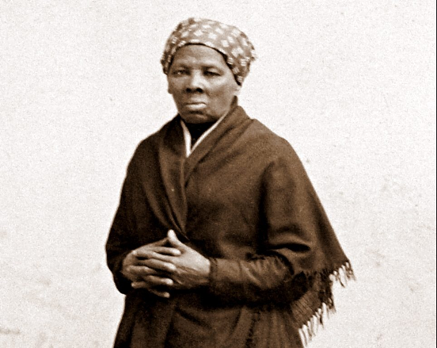
Harriet Tubman (1822-1913)
Political activist most famous for being one of the operators of the Underground Railroad
Born into slavery in Maryland -- then after she escaped, she helped to liberate her friends & family as well
After shepherding fugitives, she joined the Union Army in the Civil War
Was a scout and a spy
Famously led the raid at Combahee Ferry, which freed more than 700 people
Continued her activism as a suffragist at the turn of the century
Quote: “I was the conductor of the Underground Railroad for eight years, and I can say what most conductors can’t say — I never ran my train off the track and I never lost a passenger.” -- Tubman at a suffrage convention in 1896

Slide 11
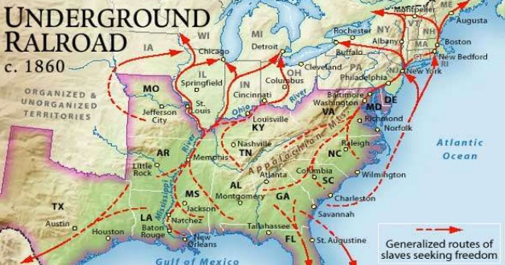
The Underground Railroad
A system of safe-houses and barns, churches, and businesses that protected freedom seekers (formerly enslaved people) away from enslavers
Helped guide 100,000 people to freedom
“Conductors”, such as Harriet Tubman, guided freedom seekers from place to place
Different safe-houses along the many routes were called “stations”, guided by “station-masters”
Conductors often posed as enslaved people and went to plantations directly
Due to the danger associated with capture, operations often occurred at night

Slide 12
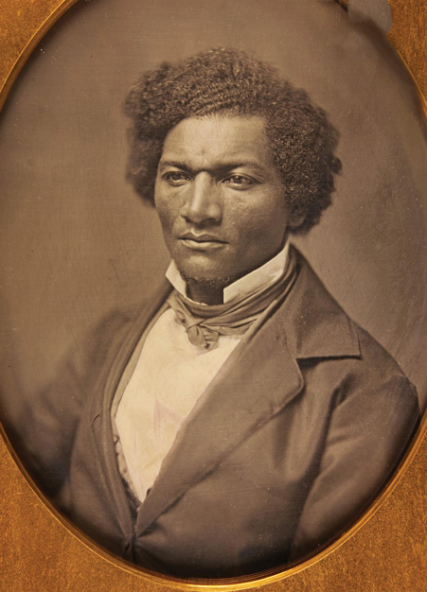
Frederick Douglass (1817-1895)
Born into slavery in Maryland, but liberated himself
Writer, preacher and orator
Spoke incisively on many social issues, first and foremost American slavery
Wrote 3 autobiographies
Actively supported women’s suffrage
Became the first Black American nominated for Vice President, running on the Equal Rights Party ticket
Watch: “What, to the slave, is 4th of July?”

Slide 13
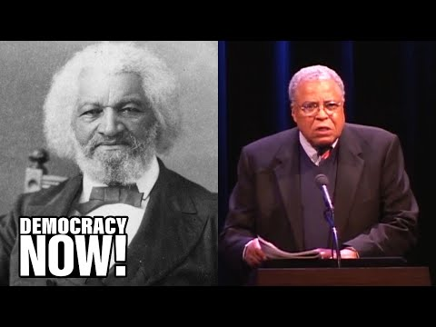
https://www.youtube.com/watch?v=O0baE_CtU08&ab_channel=DemocracyNow%21
Notes:
James Earl Jones reads “What, to the Slave, is Fourth of July?” by Frederick Douglass

Slide 14
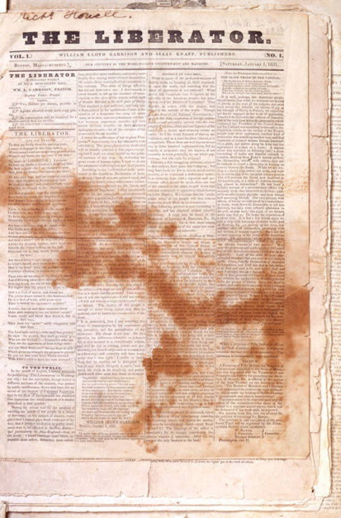
The Liberator Newspaper
An abolitionist newspaper
Ran from 1831 - 1865
Printed and published in Boston by William Lloyd Garrison
More religious than political
Appealed to the moral conscience of its readers
Demanded “immediatism”: the immediate freeing of all slaves
Became a sort of community bulletin board for abolitionists, like Frederick Douglass and Henry David Thoreau
Douglass was inspired by the Liberator to write his own, Black-led abolitionist newspaper: The North Star

Slide 15
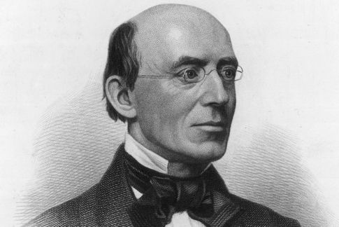
William Lloyd Garrison (1805-1879)
Writer and prominent Christian
Best known for his anti-slavery newspaper, The Liberator
Rejected American government on the basis that its engagement in war, imperialism, and slavery made it corrupt and tyrannical
Source of his beliefs and morality came from his ardent Christianity
One of the founders of the American Anti-Slavery Society

Slide 16
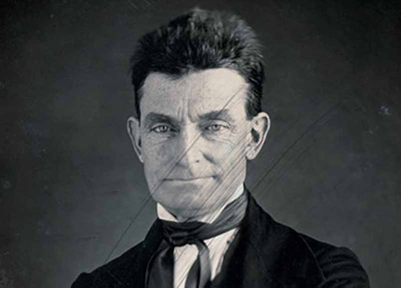
John Brown (1800-1859)
Direct organizer and guerrilla fighter
Known for fighting in Bleeding Kansas, a conflict between abolitionists and the U.S. government
Believed he was “an instrument of God”, born to strike down the system of American slavery as a “sacred obligation”
Incited and attempted slave uprising at Harper’s Ferry
Was ultimately executed by the government for “treason”

Slide 17
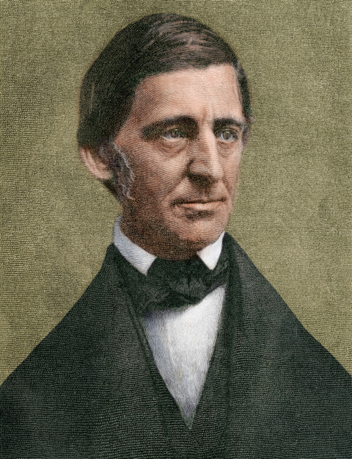
Ralph Waldo Emerson (1803-1882)
Essayist, poet, and philosopher
Prominent leader in the transcendentalism movement
One of the key figures in the American romantic movement
Famous for essays such as “Nature” and “Self-Reliance”
Known as a champion of “individualism” and the freedom of the individual
Mentor and friend of Henry David Thoreau

Slide 18
CIVIC ACTION & ENGAGEMENT
Notes:
Ways to take action to make an impact on society

Slide 19
How might you protest unjust laws in the mid-19th century?
Give a speech
Write poetry
Write an essay for a newspaper
Print and distribute pamphlets & newspapers
Purchase products made without slave labor
Attend a rally
Provide shelter to formerly enslaved people (mutual aid)
Refuse to pay taxes

Slide 20
How might you protest unjust laws today?
Provide mutual aid
Write an essay/speech
Click “like” on a cause you care about on social media
Read valid news
Talk with family members
Protest with a dedicated group
Community organizing
Vote
Campaign for an issue or candidate
Put up bumper stickers/lawn signs
Go to a march
Make a political meme
Refuse to pay taxes

